Slide 1
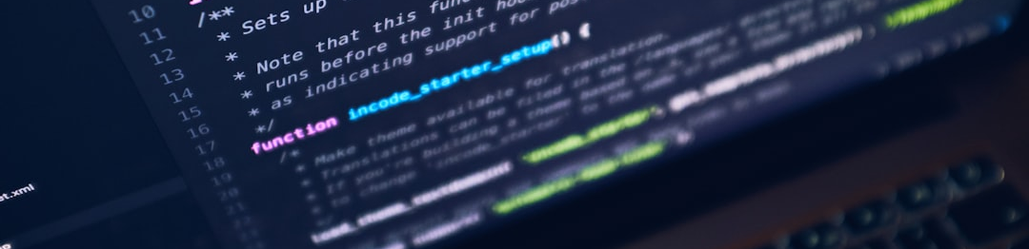
ICT Overview
Presentation by HIDAYAT ULLAH
January - 2025

Slide 2

What is a Computer?
DEFINITION AND BASIC FUNCTIONS
A computer is an electronic device that processes data and performs tasks according to a set of instructions. It consists of hardware and software components.

Slide 3
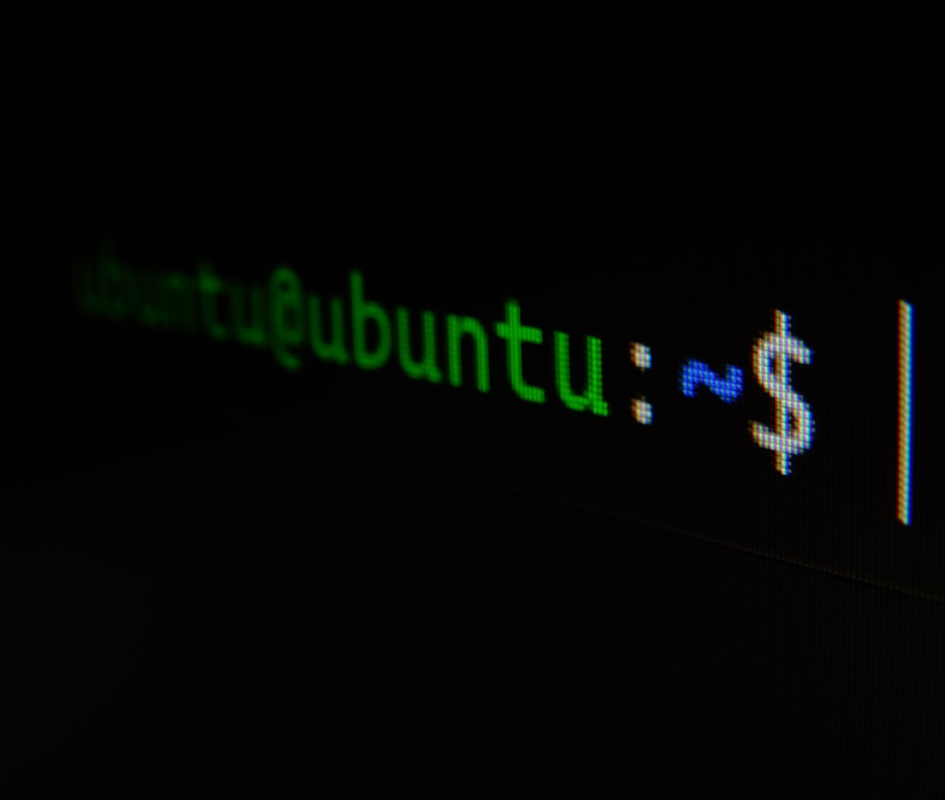
Types of Computers
PERSONAL COMPUTERS (PCS)
Desktops and laptops used for daily tasks like browsing, gaming, and office work.
SERVERS AND MAINFRAMES
Powerful machines that manage data and resources for multiple users in businesses and organizations.

Slide 4
COMPUTER COMPONENTS
This table summarizes the key components of a computer and their primary functions. Each component plays a crucial role in overall performance.
Component | Function | Example
CPU (Central Processing Unit) | Processes instructions and data | Intel i9
RAM (Random Access Memory) | Stores data temporarily for quick access | 16GB DDR4
HDD/SSD (Storage) | Stores data permanently | 1TB SSD
Motherboard | Connects all components together | ATX Motherboard

Slide 5
Software Categories
SYSTEM SOFTWARE
APPLICATION SOFTWARE
UTILITY SOFTWARE
Includes operating systems (like Windows, Linux) that manage hardware and provide a platform for applications.
This category consists of programs for specific tasks, like word processors, spreadsheets, and graphics software.
Tools that assist in system maintenance, performance enhancement, and security management, such as antivirus programs.

Slide 6
IMPACT OF ICT
40%
30%
20%
10%
ECONOMIC GROWTH
JOB CREATION
EDUCATION IMPACT
SOCIAL IMPACT
ICT significantly boosts economic performance, contributing to GDP growth in various sectors.
The ICT sector has led to the creation of millions of job opportunities globally.
ICT promotes education through online resources and makes information more accessible.
Facilitates communication and social networking, transforming how people connect.

Slide 7
Future of ICT
EMERGING TECHNOLOGIES
AI, blockchain, and IoT are set to revolutionize industries, leading to smart automation and enhanced efficiency.
GLOBAL CONNECTIVITY TRENDS
The ongoing expansion of high-speed internet access is expected to bridge digital divides and foster global collaboration.

